Slide 1
Parallel Processing

Slide 2
What is Parallel Computing?
Traditionally, software has been written for serial computation:
To be run on a single computer having a single Central Processing Unit (CPU);
A problem is broken into a discrete series of instructions.
Instructions are executed one after another.
Only one instruction may execute at any moment in time.

Slide 3
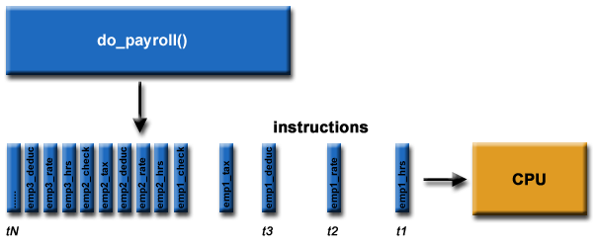
Example :- do_payroll()

Slide 4
Parallel Computing…..
In the simplest sense, parallel computing is the simultaneous use of multiple compute resources to solve a computational problem: To be run using multiple CPUs
A problem is broken into discrete parts that can be solved concurrently
Each part is further broken down to a series of instructions
Instructions from each part execute simultaneously on different CPUs

Slide 5
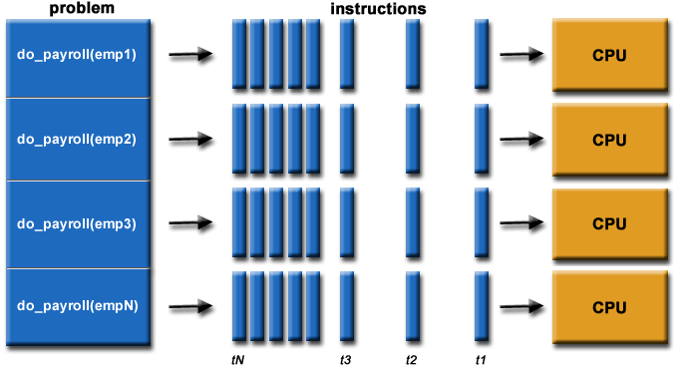
Parallel Processing - Example

Slide 6
Parallel Processing: Characteristics
The compute resources might be:
A single computer with multiple processors;
An arbitrary number of computers connected by a network;
A combination of both.
The computational problem should be able to:
Be broken apart into discrete pieces of work that can be solved simultaneously;
Execute multiple program instructions at any moment in time;
Be solved in less time with multiple compute resources than with a single compute resource.

Slide 7
Parallel Processing
PP involves Multiple processes which are active simultaneously and solving the given problem, generally on multiple processors.
Execution of concurrent events in the computing process to achieve faster computational speed.
We must have multiple processes which are simultaneously active.-----Processing Units.

Slide 8
Parallel Computer Structures
Parallel computers are those systems that emphasize parallel processing.
Three architectural configuration :
Pipeline Computers – performs overlapped computations to exploit temporal parallelism
Array Processors – multiple synchronized arithmetic logic units to achieve spatial parallelism
Multiprocessor Systems – achieves asynchronous parallelism through a set of interactive processors with shared resources(memories , databases etc..)

